Slide 1
Gene set enrichment analysis
Genomics sub-group meeting 3
2020/02/17
Jon Sánchez Valle

Slide 2
Outline
DAVID
g:Profiler
ToppGene
GSEA
Other methods + visualization

Slide 3
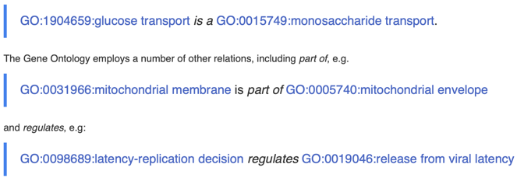
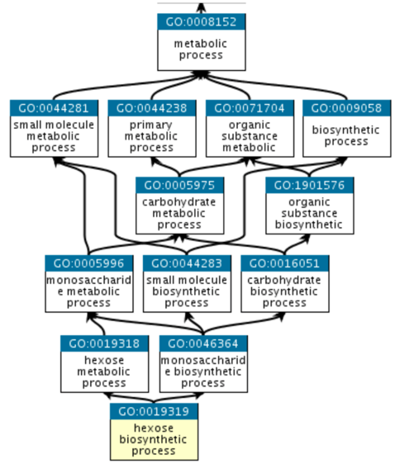
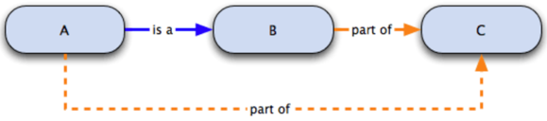
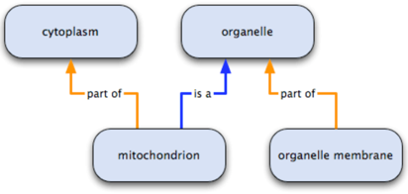
Gene Ontology

Slide 4
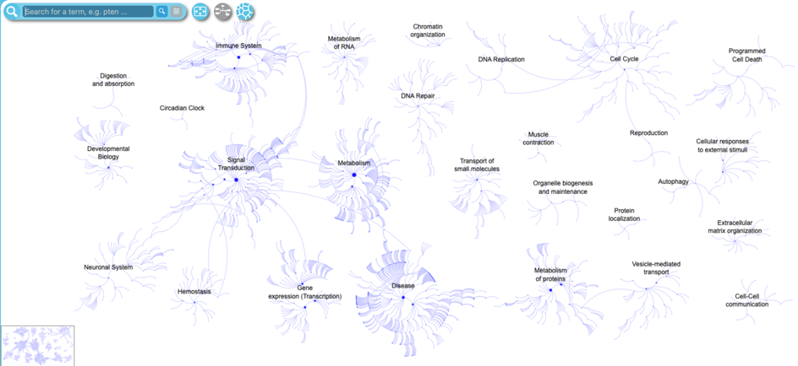

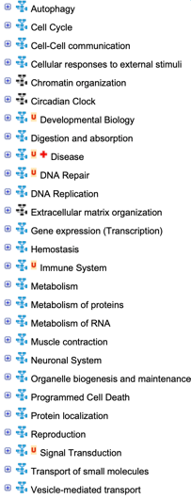
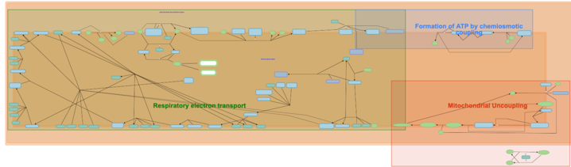
Reactome

Slide 5
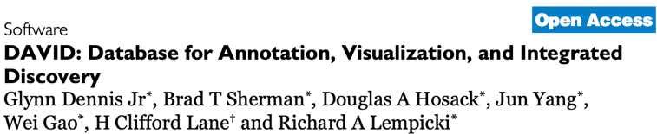
DAVID (Database for Annotation, Visualization, and Integrated Discovery)
Genome Biology
14 August, 2003
4,145 citations

Slide 6
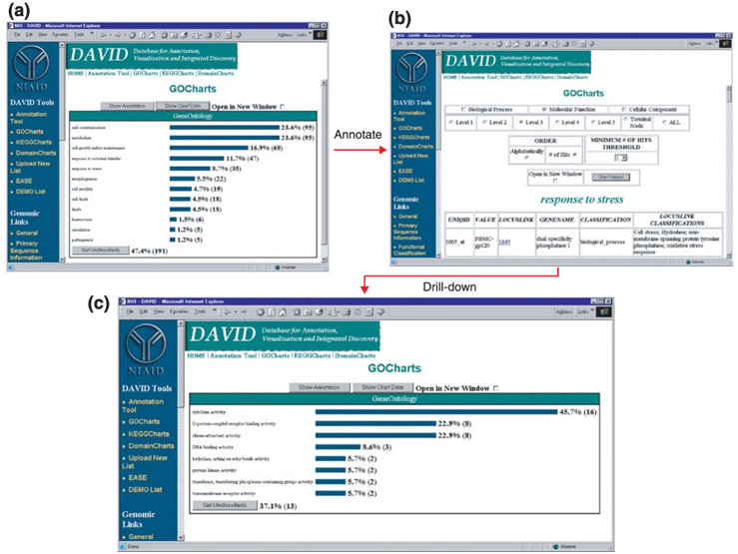
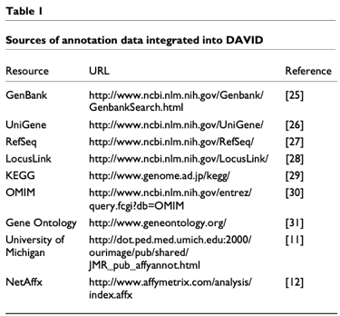
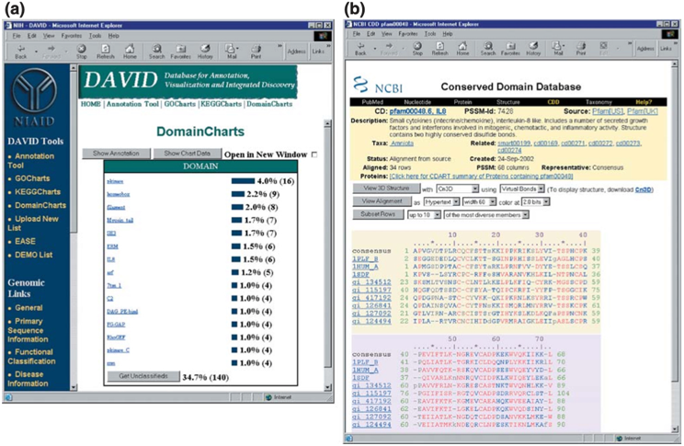
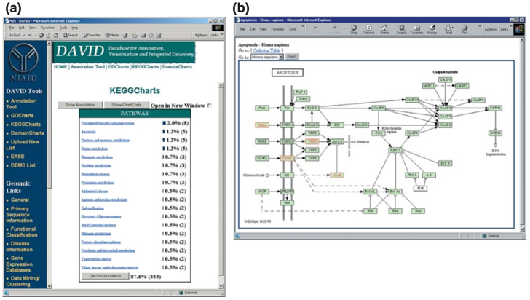
DAVID
Expedites functional annotation and analysis of genes encoded by human, mouse, rat or fly genomes
Download weekly data from:
Annotation Tool
GoCharts module
Gene symbol
GenBank
OMIM
Affymetrix
Biological process
Molecular function
Cellular component
Graphycally display the distribution of DEG among functional categories
Gives you the number of genes by category
DomainCharts module
KeggCharts module
PFAM protein domains
KEGG biochemical pathways
Domain designations are linked to the Conserved Domain Database where details regarding domain function, structure and squence are available

Slide 7
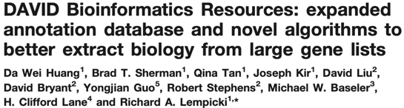
DAVID (Database for Annotation, Visualization, and Integrated Discovery)
Genome Biology
14 August, 2003
4,145 citations
Nucleic Acids Research
22 January, 2007
781 citations

Slide 8
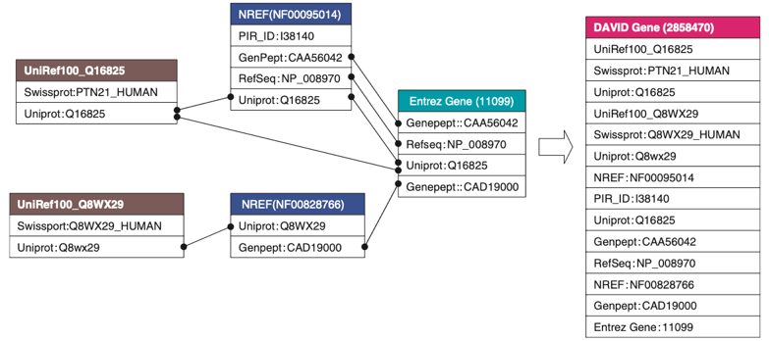
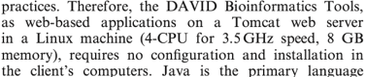
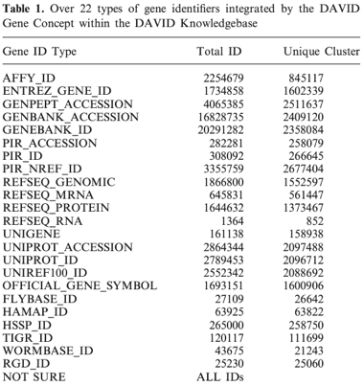
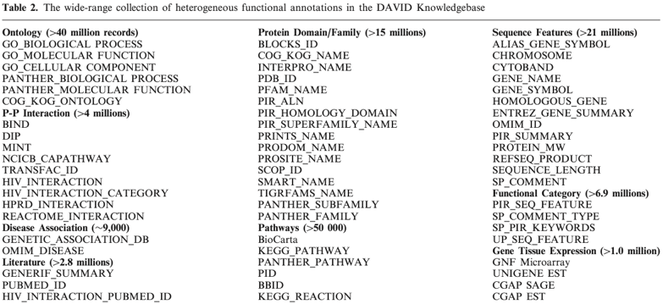
DAVID

Slide 9
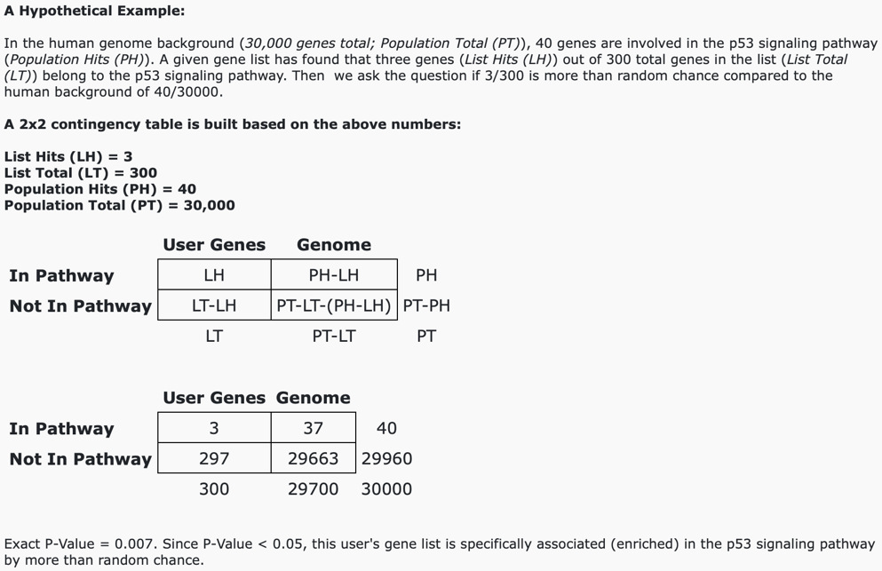
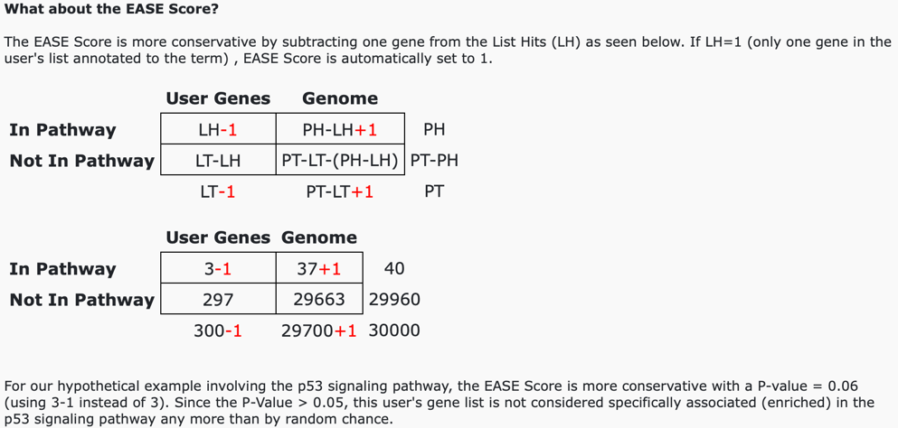
DAVID

Slide 10
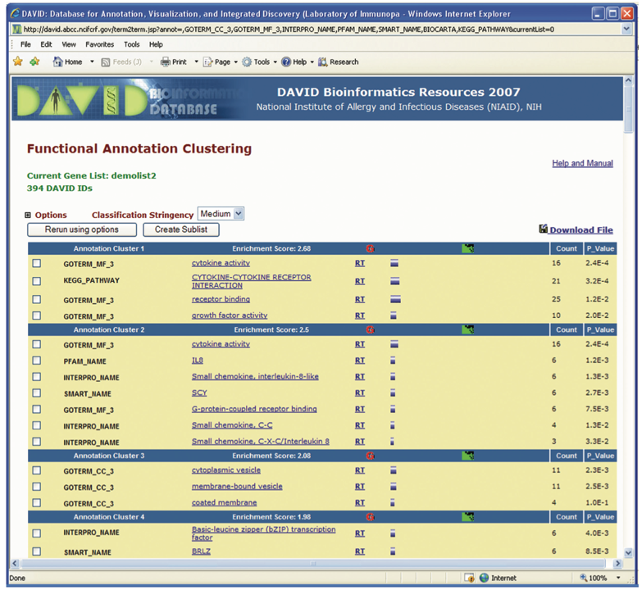
DAVID
DAVID Functional Annotation Clustering
hyperlinks
Measure relationships between anotated terms based on the association of their genes
Group similar and redundant annotations from the same or different resources

Slide 11
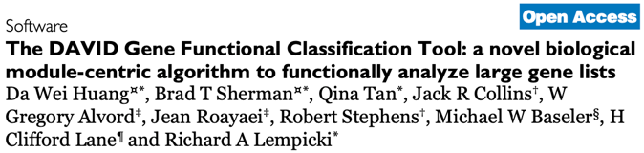
DAVID (Database for Annotation, Visualization, and Integrated Discovery)
Genome Biology
14 August, 2003
4,145 citations
Nucleic Acids Research
22 January, 2007
781 citations
Genome Biology
4 September, 2007
887 citations

Slide 12
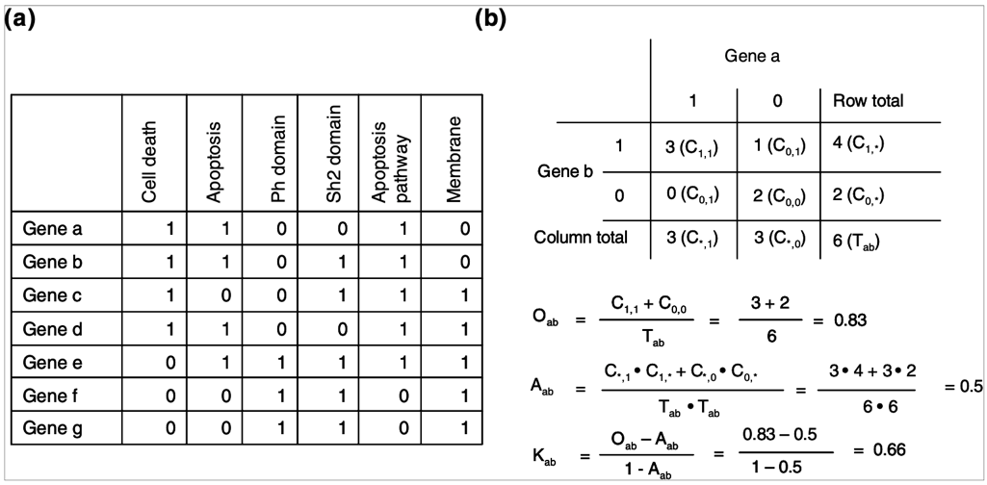
DAVID
Measure functional relations of gene-pairs based on their annotations
Observed co-occurrence
Chance of co-occurence
Degree of annotation co-occurrence between genes a and b

Slide 13
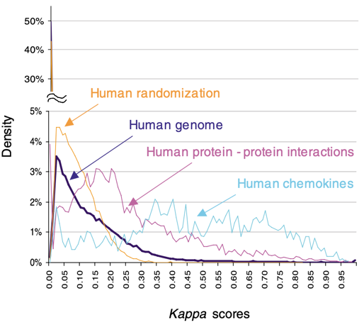
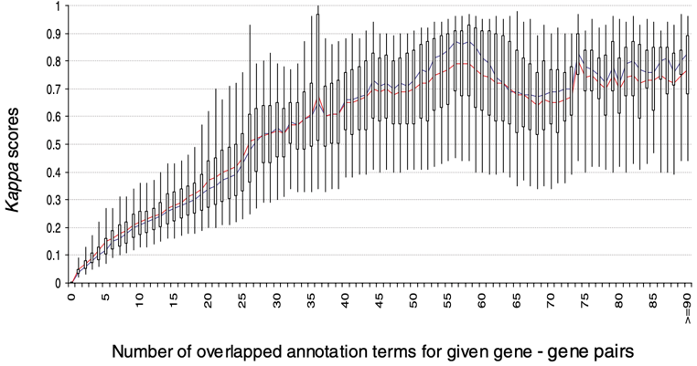
DAVID

Slide 14
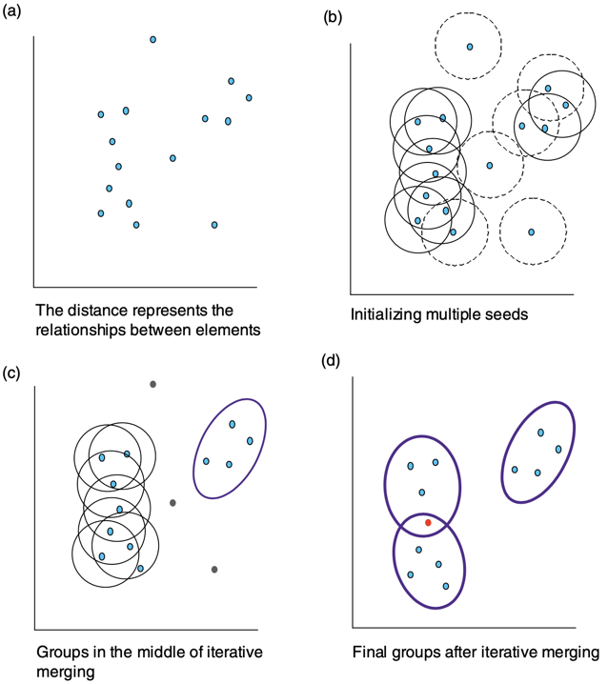
DAVID
Evaluate the quality of the agglomeration algorithm
Agglomeration method to classify a gene list into functionally related groups based on the functional similarity scores
Randomly select genes that belong to the same protein family (kinases, phosphatases…)
K-means, FANNY and SOM
Classify the genes
Heuristic fuzzy multiple-linkage partitioning agglomeration approach
Genes not classified into the group they belong to
Genes classified into groups they don’t belong to
1-2%
2-5%

Slide 15
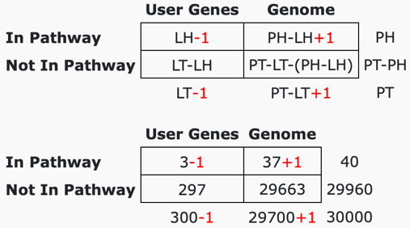
DAVID
Which functional gene groups are more significant for the experiment?
(order the groups by their relative importance)
A gene group is more important if the majority of the genes are associated with highly enriched terms
Geometric mean of the EASE scores associated with the terms that belong to the gene group
(both significant and non-significant)
Minus log transformation
Group enrichment score

Slide 16
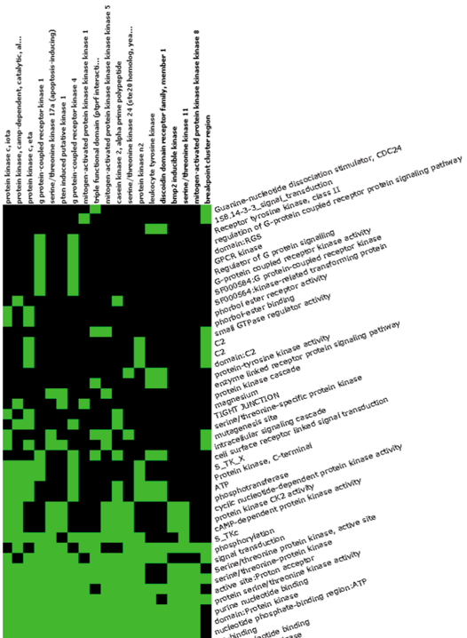
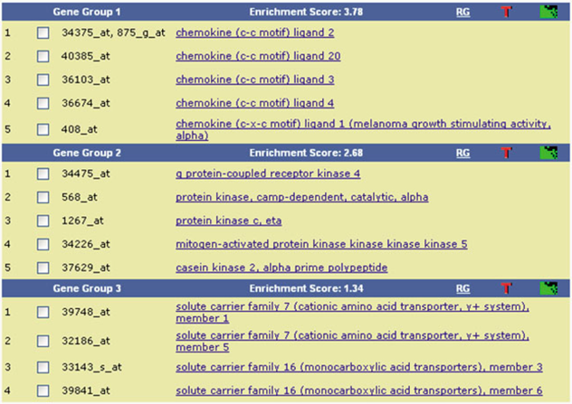
DAVID

Slide 17
DAVID
DAVID Functional Annotation Clustering
hyperlinks
Measure relationships between anotated terms based on the association of their genes
Group similar and redundant annotations from the same or different resources

Slide 18
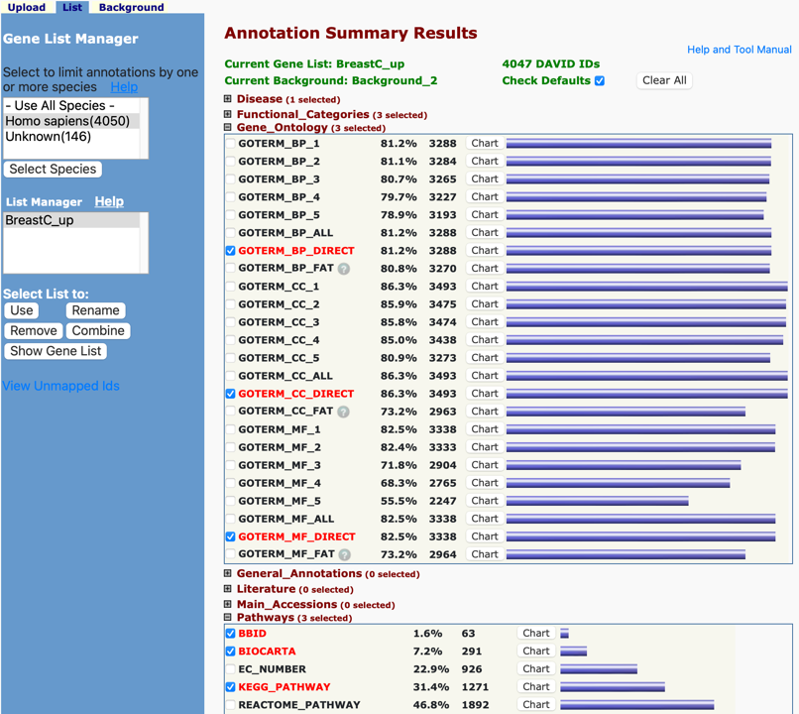
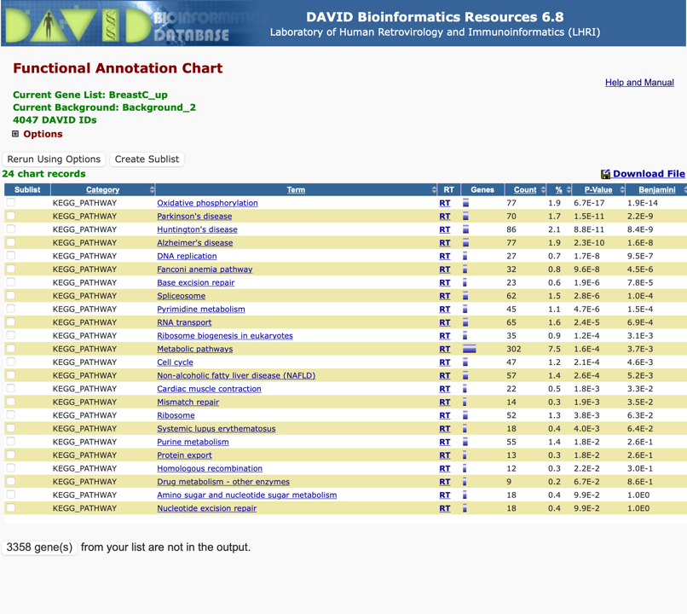
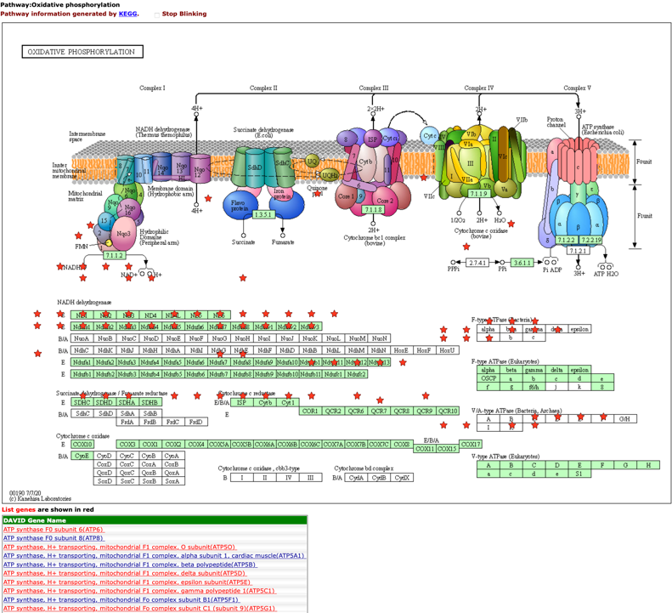
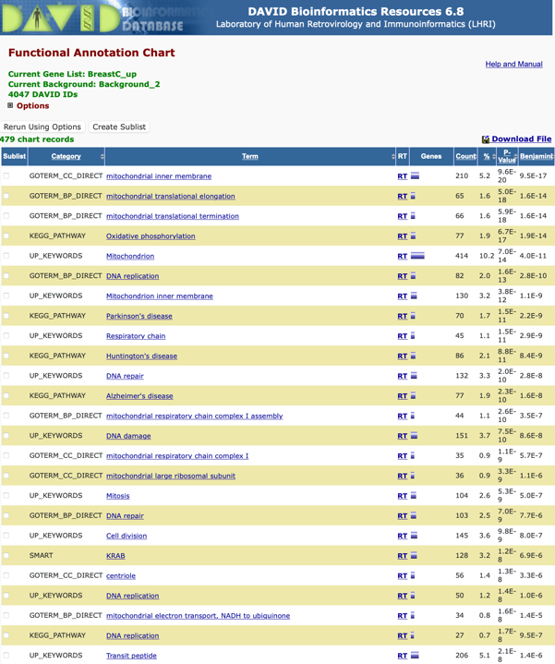
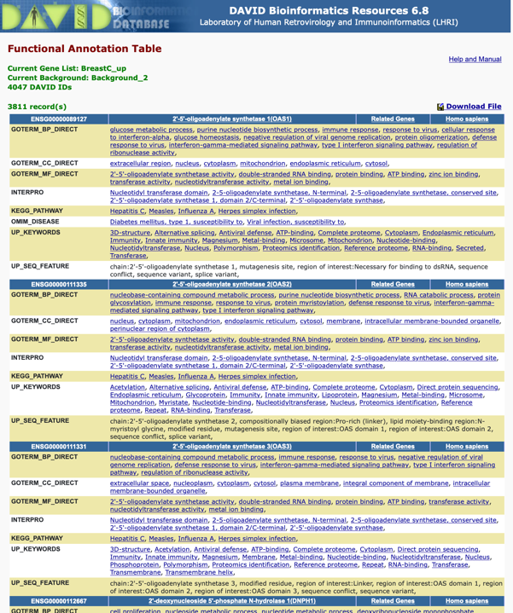

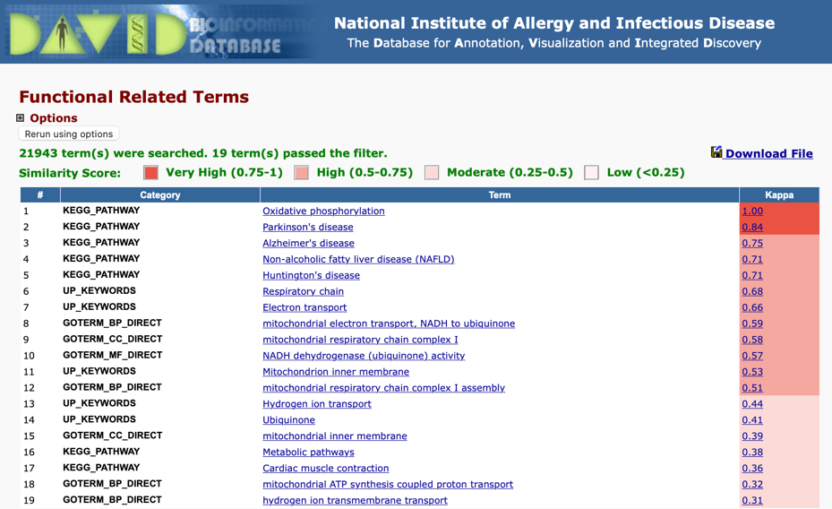
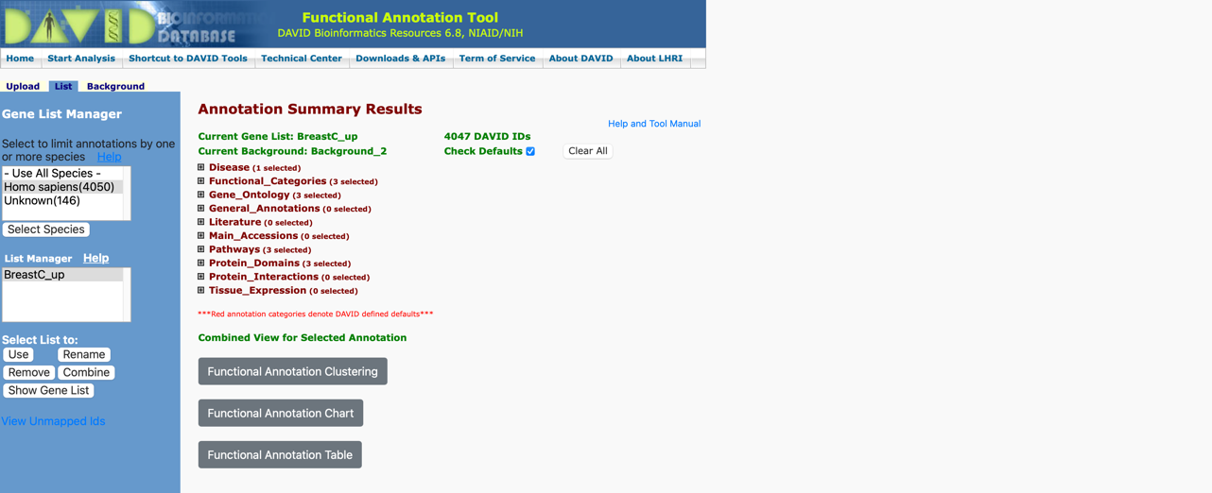
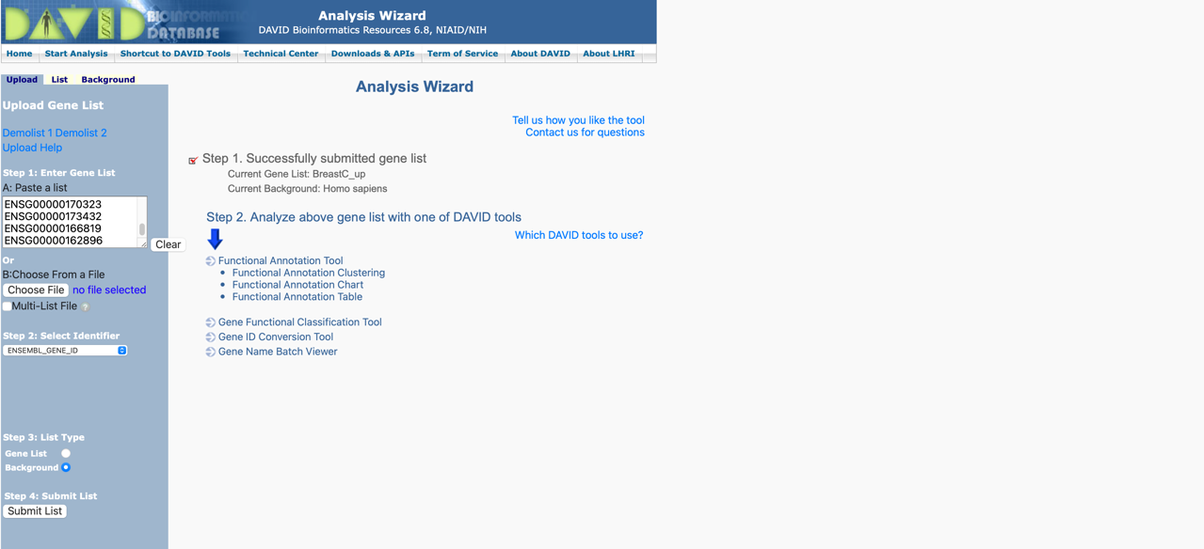
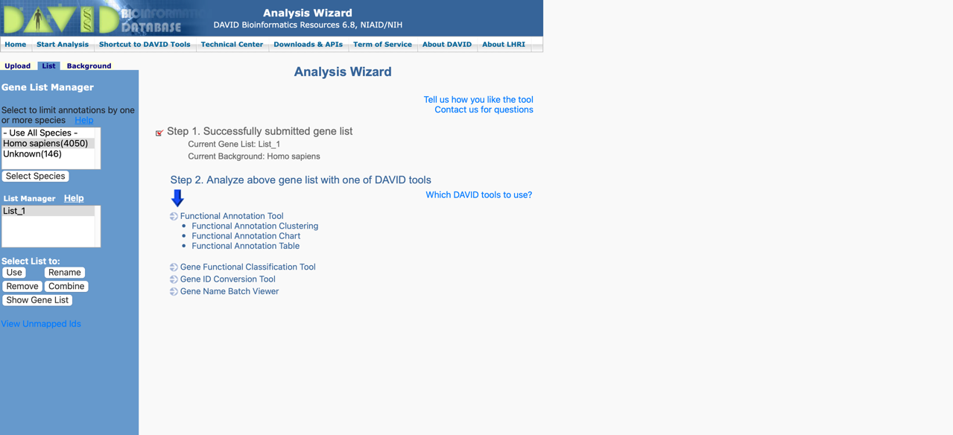
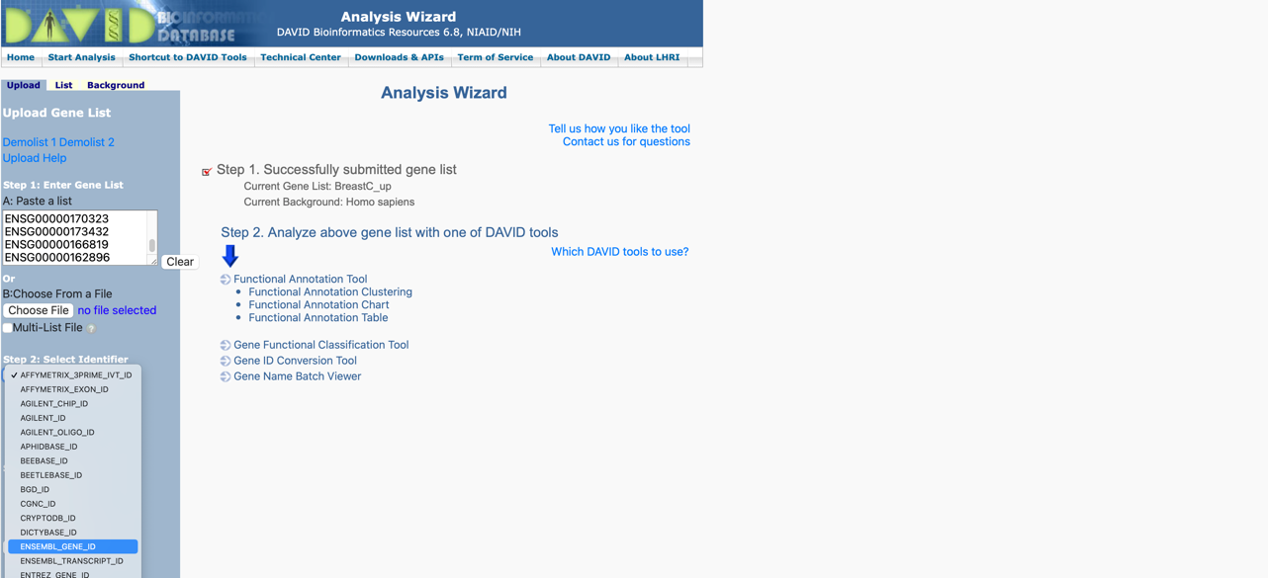
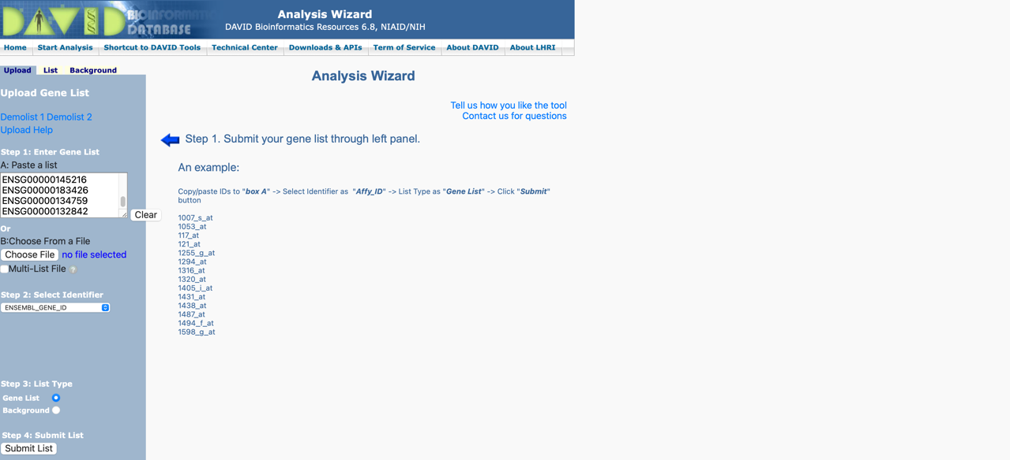
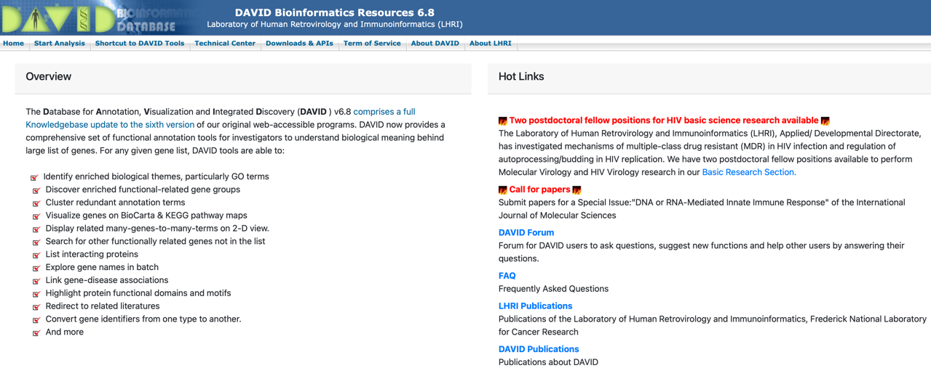
DAVID

Slide 19
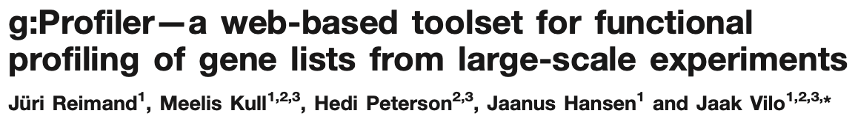
G:Profiler
Nucleic Acids Research
28 March, 2007
376 citations
Ease of use
Informative visual presentation of the results
Supports ranked gene lists
Works with most gene identifiers (even mixed)
Convert gene IDs
Find orthologous genes from other species
Supports probe identifier for 31 species

Slide 20
G:Profiler
4 modules
G:PROFILER core
Identify pathways or biological processes enriched in the provided list
GO, KEGG, Reactome and TRANSFAC
Enriched pathways ranked by significance
Size of the query
Number of genes in the pathway
Ordered list
incrementally probes all possible sizes of the list and determine functional annotations and cut-points
Register how the pvalues change while increasing the size of the list of genes

Slide 21
G:Profiler
4 modules
G:PROFILER core
G:SORTER
Identify pathways or biological processes enriched in the provided list
GO, KEGG, Reactome and TRANSFAC
Gene expression similarity-based analysis
Similarly or oppositely expressed genes from GEO datasets
Enriched pathways ranked by significance
Size of the query
Number of genes in the pathway
Input: 1 gene ID
Select expression dataset
Correlation measure
Size of the list of genes
Obtain the “n” genes that are more similar to gene “x”
Enrichment of the list of genes
Ordered list
incrementally probes all possible sizes of the list and determine functional annotations and cut-points
Register how the pvalues change while increasing the size of the list of genes

Slide 22
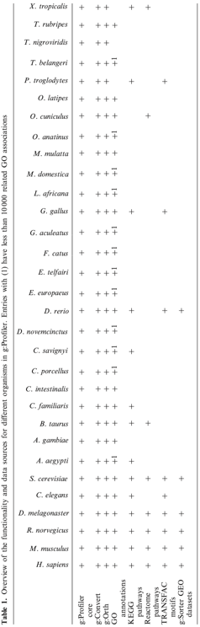
G:Profiler
4 modules
G:PROFILER core
G:SORTER
G:CONVERT
G:ORTH
Identify pathways or biological processes enriched in the provided list
GO, KEGG, Reactome and TRANSFAC
Gene expression similarity-based analysis
Convert gene IDs
Identify orthologous genes from other species
Similarly or oppositely expressed genes from GEO datasets
List of gene names, Ids, proteins or microarray probes
Data is downloaded from Ensembl database
Enriched pathways ranked by significance
Size of the query
Number of genes in the pathway
Input: List of genes
Select target organism
Tabular file with the corresponding orthologs
Tabular file with the corresponding names and Ids for each gene
+
short description of the gene
Obtain the “n” genes that are more similar to gene “x”
Ordered list
incrementally probes all possible sizes of the list and determine functional annotations and cut-points
Register how the pvalues change while increasing the size of the list of genes

Slide 23
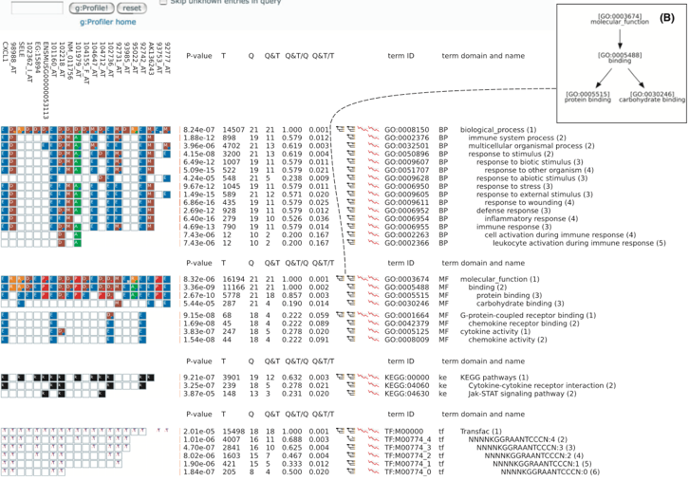
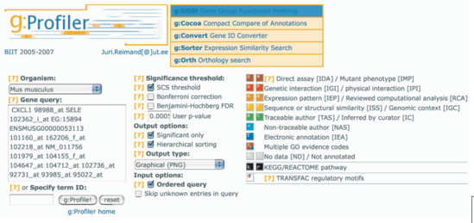
G:Profiler

Slide 24
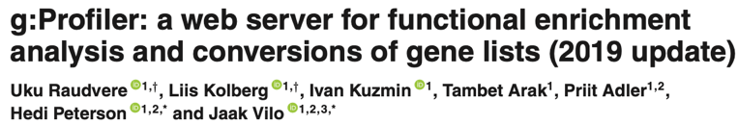
G:Profiler
Nucleic Acids Research
28 March, 2007
376 citations
Nucleic Acids Research
29 April, 2007
251 citations

Slide 25
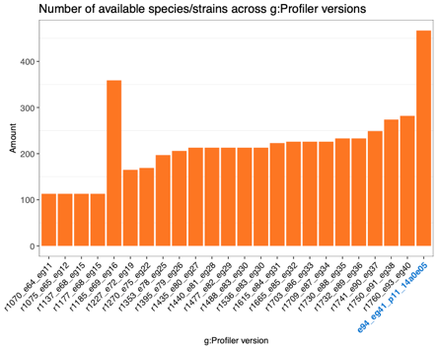
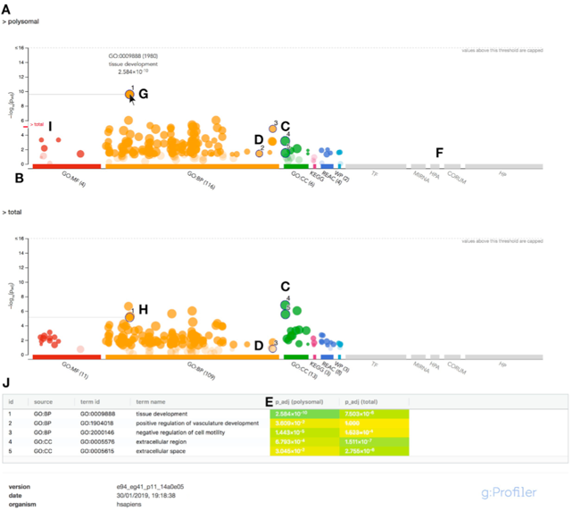
G:Profiler
G:PROFILER core
g:GOSt
g:SNPense
Identify terms enriched in the provided list
GO, KEGG, Reactome and TRANSFAC, WikiPathways, miRNA targets (miRTar-Base), tissue-specificity (Human Protein Atlas) and Human Phenotype Ontology
Map SNP rs-codes to gene names
Obtain chromosomal coordinates and predict variant effects.

Slide 26
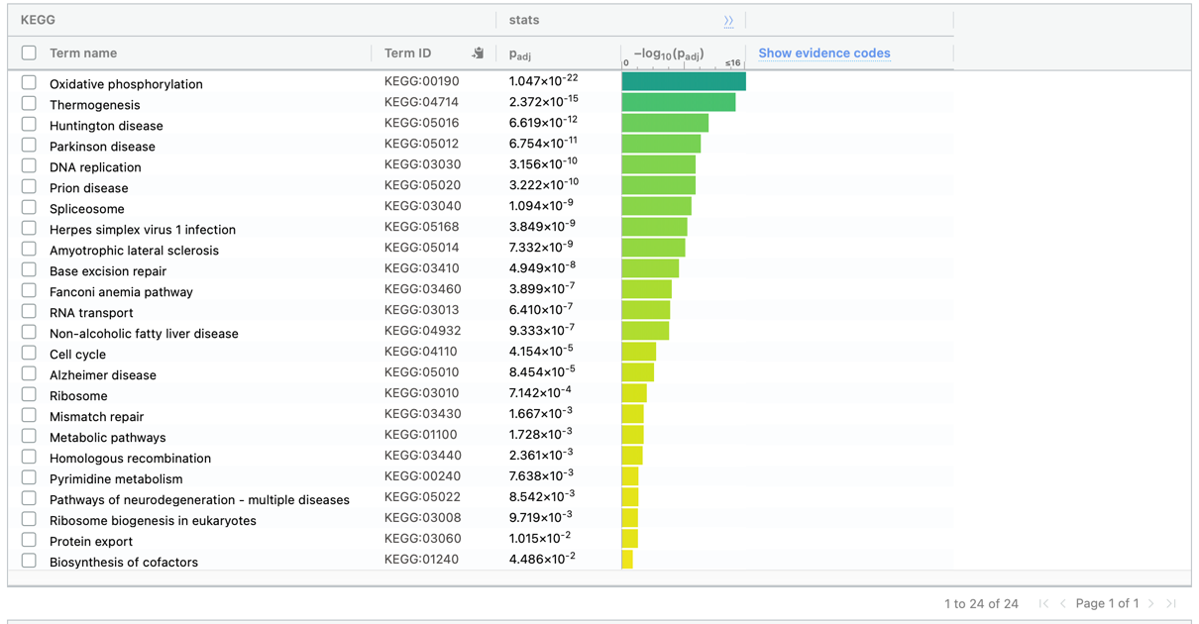
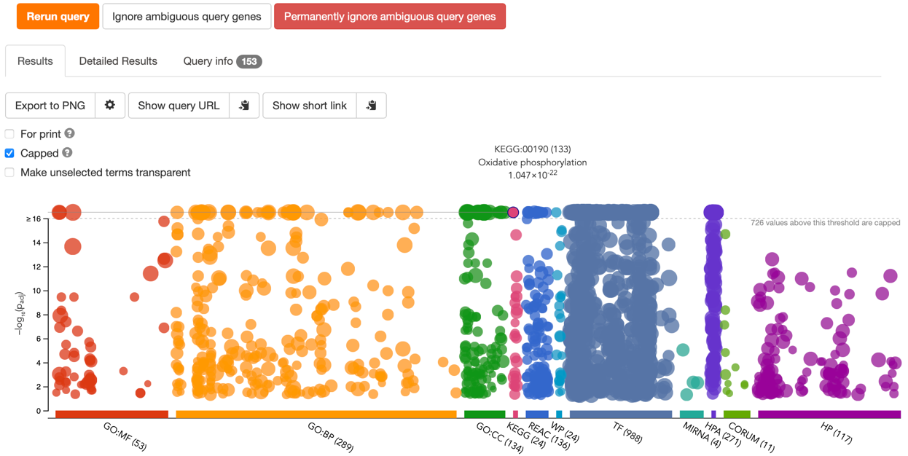
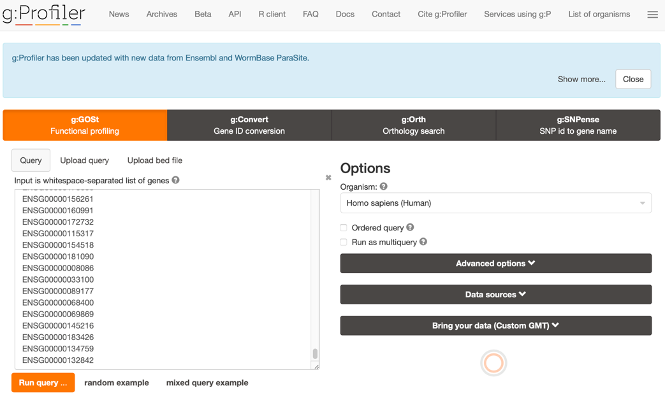
G:Profiler

Slide 27


G:Profiler

Slide 28


G:Profiler
268 pathways
493 pathways

Slide 29

ToppGene
Nucleic Acids Research
May 11, 2009
924 citations

Slide 30








ToppGene
Fuzzy measure
MTMR4
MTMR8
Probability of term T_{k}
Nº occurrences of term K and it’s children
P(T_{k}) =
Total Nº of terms
g^{k} =
-ln(p(T_{k}))
max{-ln(p(T_{j}))}
Densities for G1 and G2
G1
G2
Fuzzy-based similarity measure:
S_{FMS}(G₁,G₂)=0.86

Slide 31






ToppGene

Slide 32


ToppGene

Slide 33


GSEA
August 2, 2005
13,302 citations

Slide 34






GSEA (method)
Correlation with the phenotype
Gene set of interest
ES = max(P_{hit} – P_{miss})
Position in the ranked list
Number of genes in the gene set
Total number of genes
up-regulated
Signal to noise ratio
Differential gene expression analysis
Correlation with the phenotype
Leading edge subset
Core members of high scoring gene sets
down-regulated
Ranked based on the Fold Changed

Slide 35

GSEA (method)
Sample the labels of the phenotypes and calculate the new ES_{NULL}
Sample the labels of the genes and calculate the new ES_{NULL}
or
Enrichment Score
ES
p-value
1000 permutations
ES
NES =
mean ES_{NULL}
mean ES_{NULL}
ES_{NULL}
NES_{NULL} =
FDR
mean ES_{NULL}

Slide 36

GSEA
http://www.gsea-msigdb.org/gsea/index.jsp

Slide 37


GSEA

Slide 38













GSEA
…

Slide 39


GSEA

Slide 40



GSEA

Slide 41

GSEA
for a in `ls Ranked/`; do java -Xmx2000m -cp ./gsea.jar xtools.gsea.GseaPreranked -gmx gseaftp.broadinstitute.org://pub/gsea/gene_sets_final/c2.cp.kegg.v7.0.symbols.gmt,gseaftp.broadinstitute.org://pub/gsea/gene_sets_final/c2.cp.reactome.v7.0.symbols.gmt,gseaftp.broadinstitute.org://pub/gsea/gene_sets_final/c5.bp.v7.0.symbols.gmt -collapse true -mode Max_probe -norm meandiv -nperm 1000 -rnk /Users/jonsanchezvalle/Desktop/Pathways/Ranked/$a -scoring_scheme weighted -rpt_label ${a/%????} -chip gseaftp.broadinstitute.org://pub/gsea/annotations/ENSEMBL_human_gene.chip -include_only_symbols true -make_sets true -plot_top_x 20 -rnd_seed timestamp -set_max 500 -set_min 15 -zip_report false -out /Users/jonsanchezvalle/Desktop/Pathways/Results -gui false; done

Slide 42



GSEA
http://software.broadinstitute.org/cancer/software/gsea/wiki/index.php/Data_formats

Slide 43

GSEA (available metrics)

Slide 44


Other methods for gene set enrichments

Slide 45




Visualization

Slide 46




Visualization

Slide 47


Other methods
TAPPA
PWEA
CLIPPER
PRS
DEGraph
SPIA
CePa
NetGSA
Pathifier
Pathway topology based
Mechanistic pathway activity

